Slide 1


WELCOME

Slide 2

INTRODUCTION
ROUFUN NAHAR
Assistant Teacher( English)
Jamalpur Govt. Girls’ High School
Jamalpur.
SUBJECT: English 1st Paper
CLASS: Eight
UNIT: One (Going on a foreign trip)
LESSON: One
Topic: At the airport

Slide 3
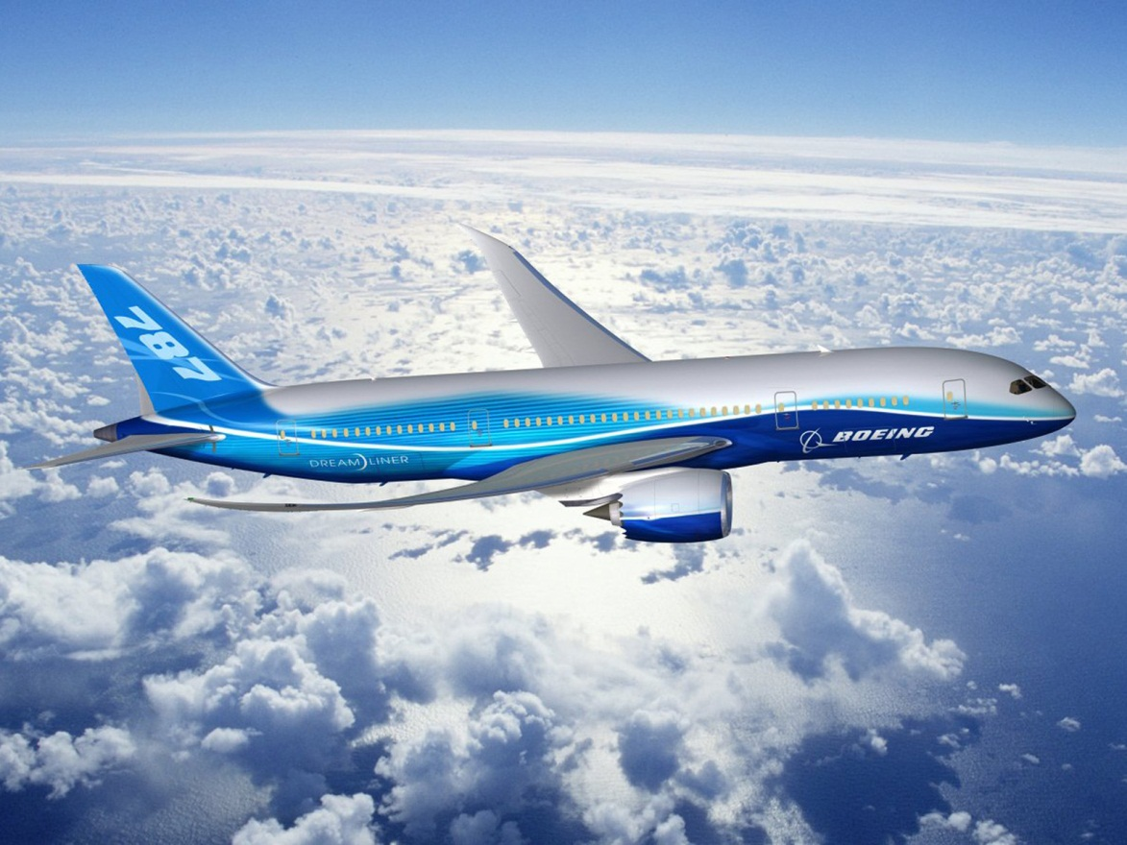
What can you see in the picture?

Slide 4
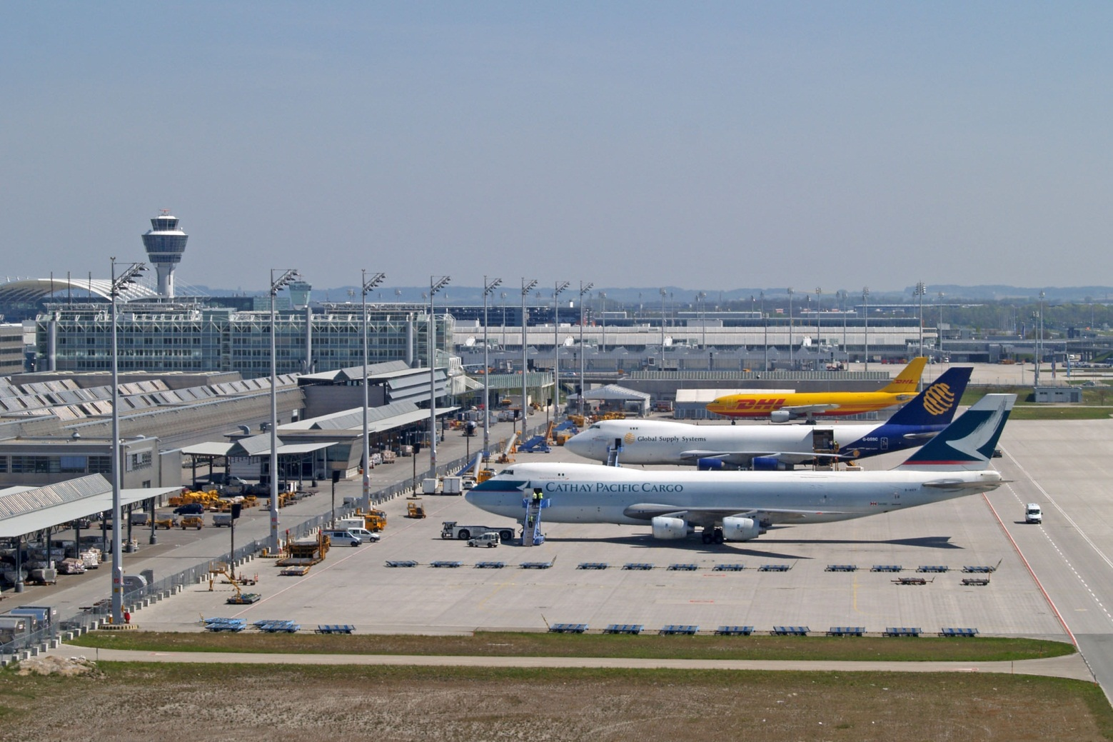
At the airport
Can you guess what is the place?

Slide 5
Topic’s name:
At the airport
Unit One
Lesson 1
Time: 50min.

Slide 6

OBJECTIVES OF THE LESSON
By the end of the lesson the students will be able to
Ask and answer questions. (Speaking skill)
Read and understand text. (Reading skill)
Write answers to questions. (Reading & Writing skill)
Write a short composition. (Writing skill)
Vocabulary(Lounge, Immigration)

Slide 7
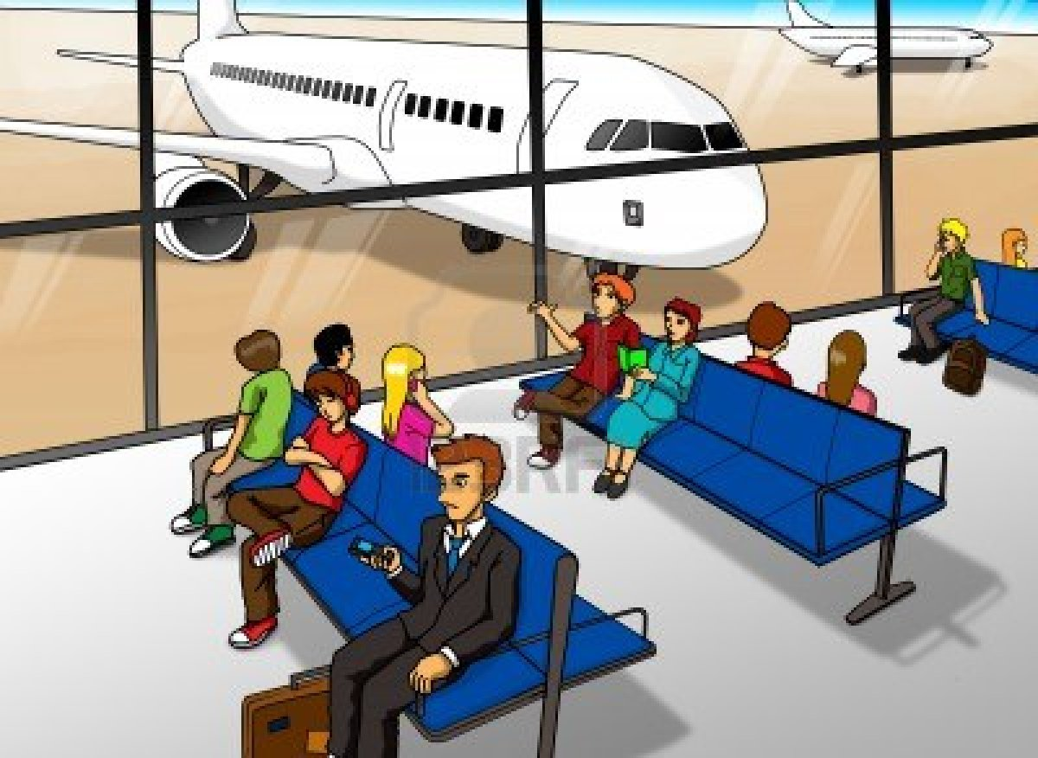
Lounge
A room for waiting in at an airport

Slide 8

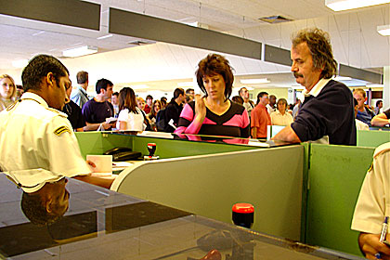
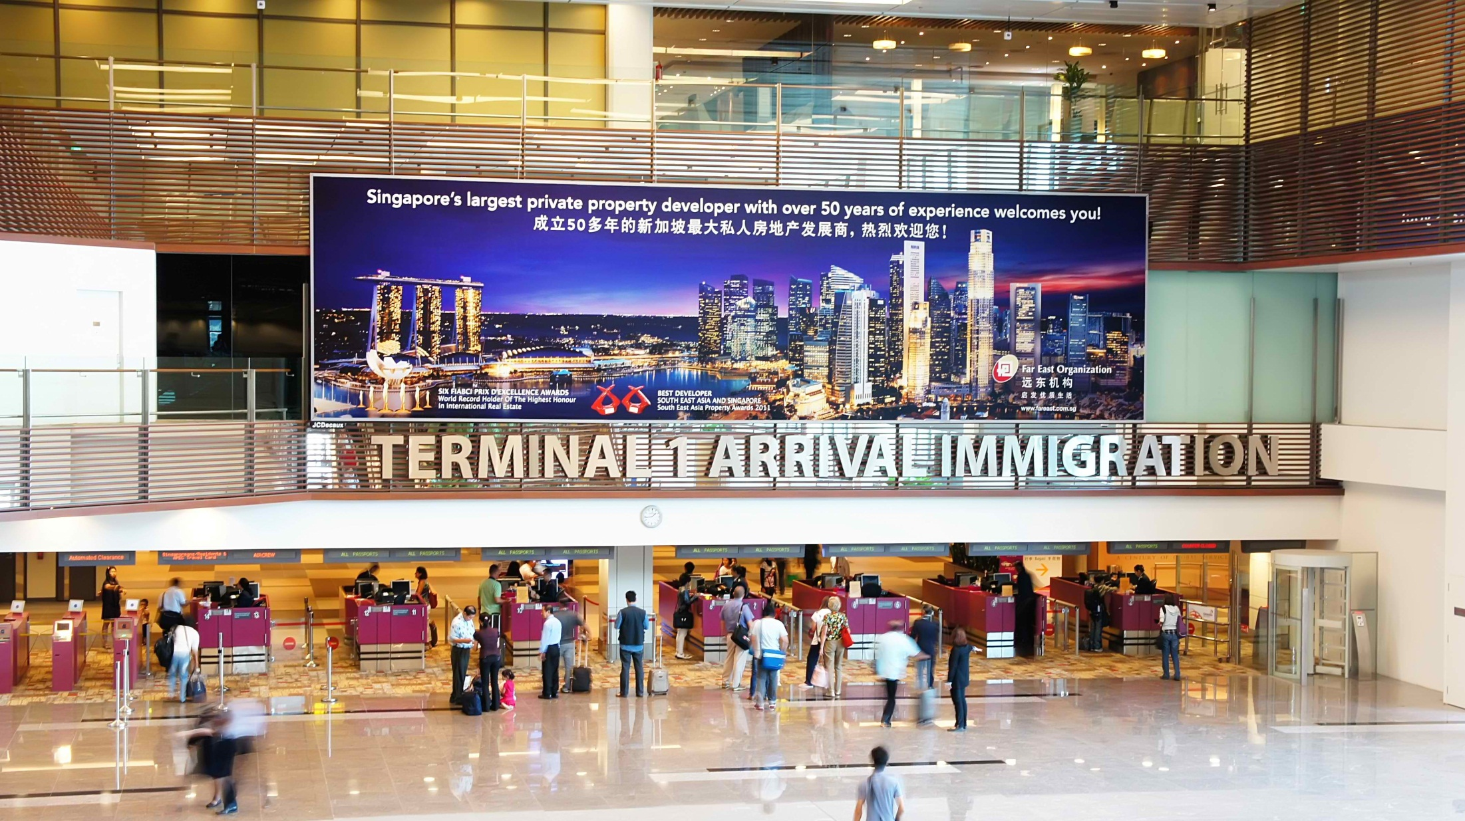
Immigration

Slide 9
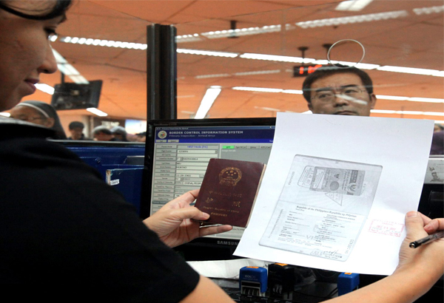
An area at an airport, a sea port, etc. at which the
passports and other documents of people wanting
to come into a country are checked

Slide 10
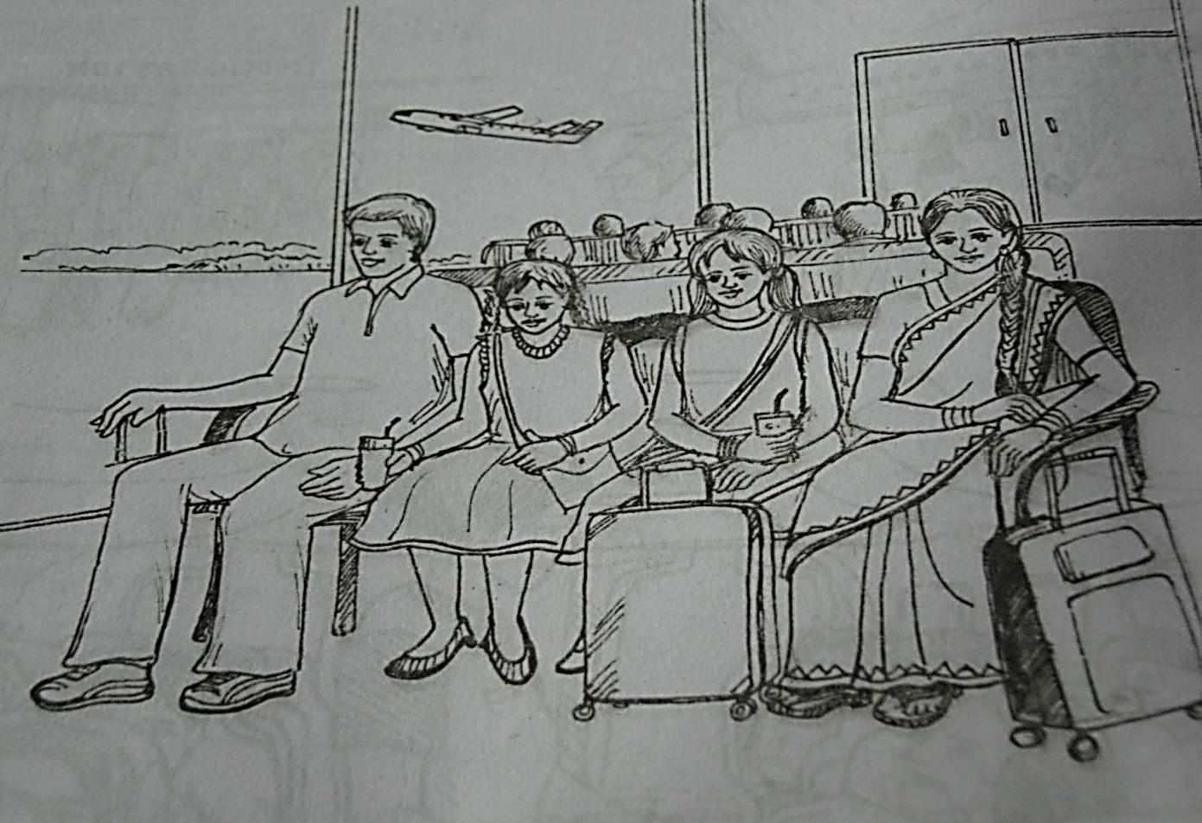


Talk about the picture with your partner
according to the following questions.(3min.)
1. What do you see?
2. Can you guess where it could be?
3. Who are the people in the picture?
4. What could be their relationship?

Slide 11

Read the text from the book and write answer of the following questions.
1. Why is Mita excited?
Ans: Mita is excited because this is her first time to board a plane.
2. Why aren’t Mita’s parents going with her?
Ans: Mita’s parents were too busy with their work.
3. What does an immigration officer do at the airport?
Ans: An immigration officer checks passport and stamps it.

Slide 12
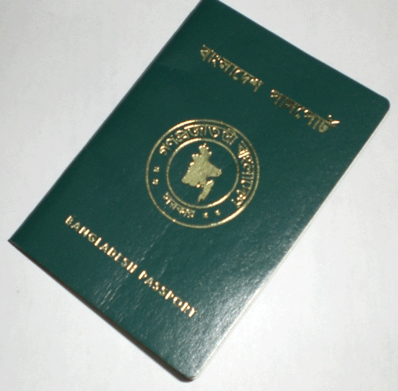
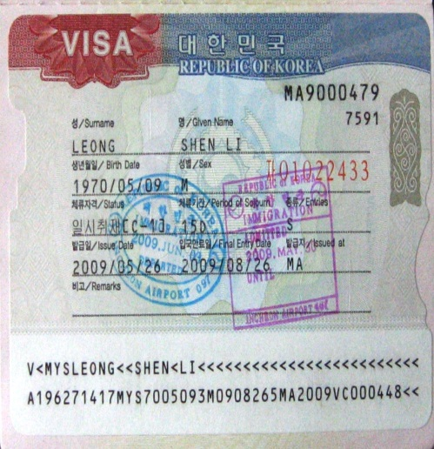
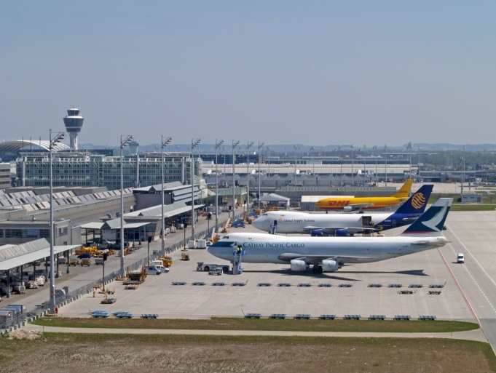
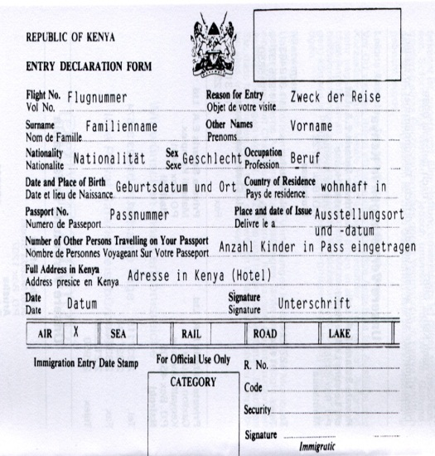
Preparation for going abroad

Slide 13

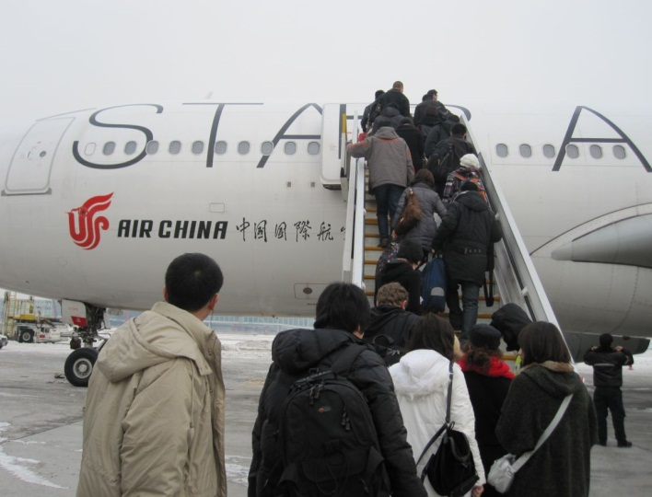
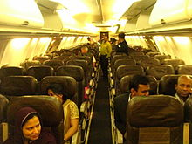
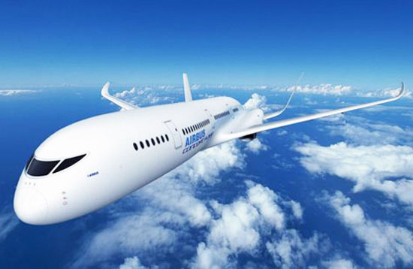
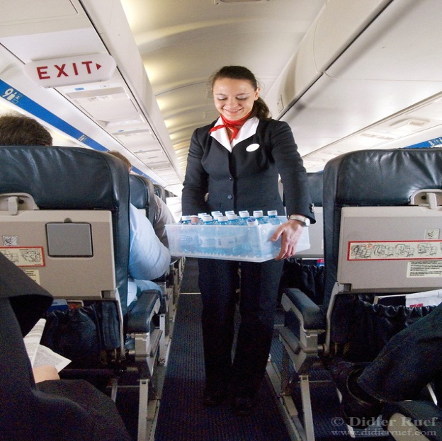
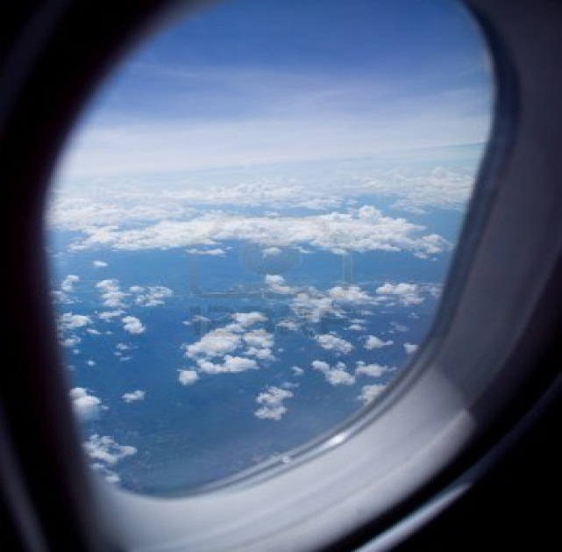
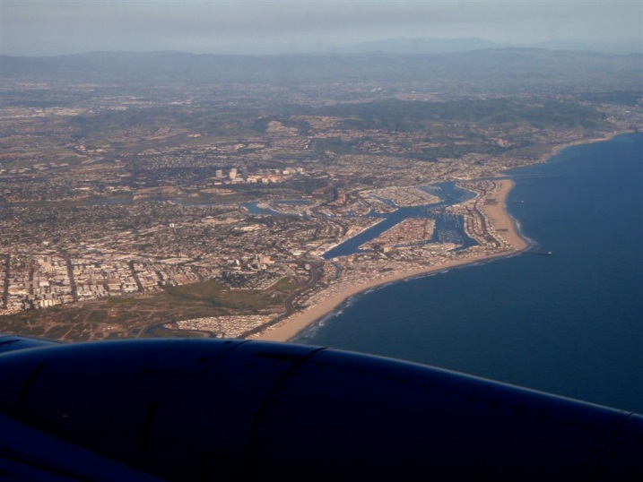
On the way while travelling
Boarding on the plane
Having seat
Plane flying
Air hostess’ service
Exciting view from the window

Slide 14
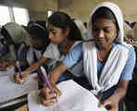
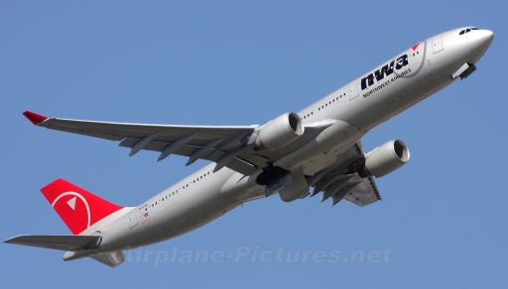
Individual Work
Think you are going to travel to Singapore by a plane.
Now write a short composition about your preparation before travelling and your experience on the way. (10 min.)

Slide 15
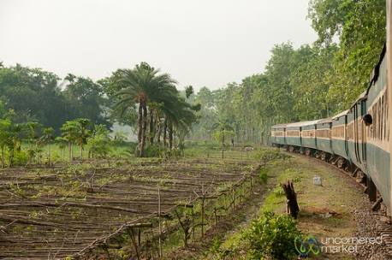
A trip to your grandparents’ house
Journey By A Train
Have A Look

Slide 16
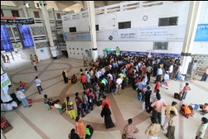
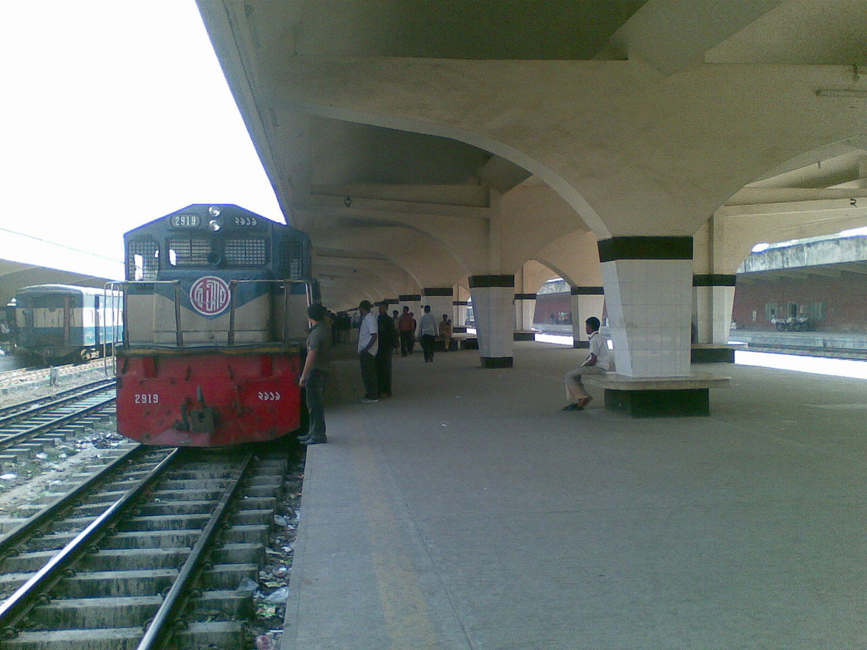

Slide 17
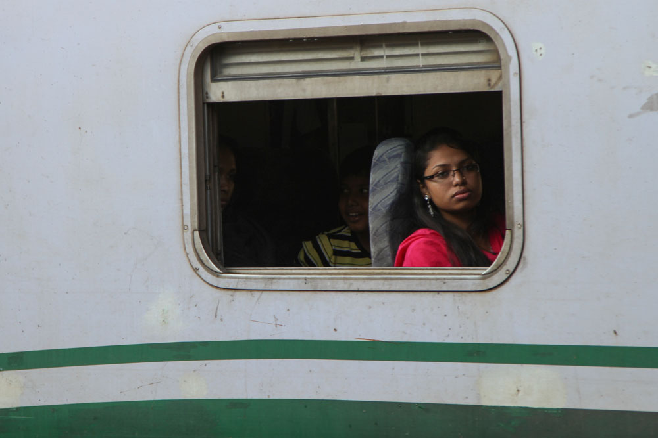
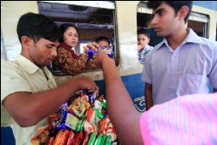
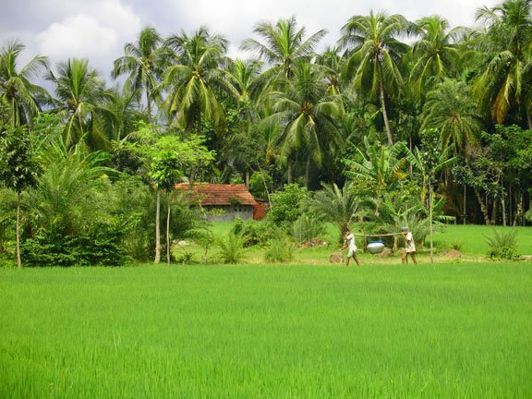
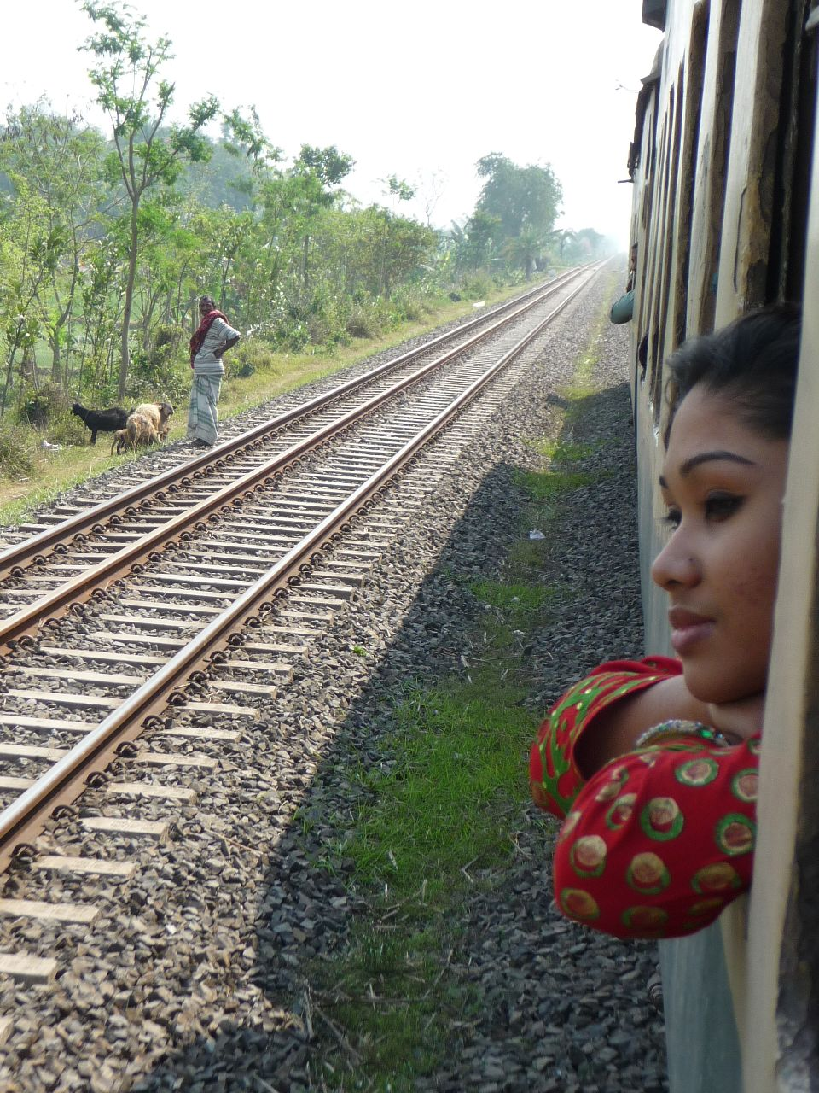

Slide 18
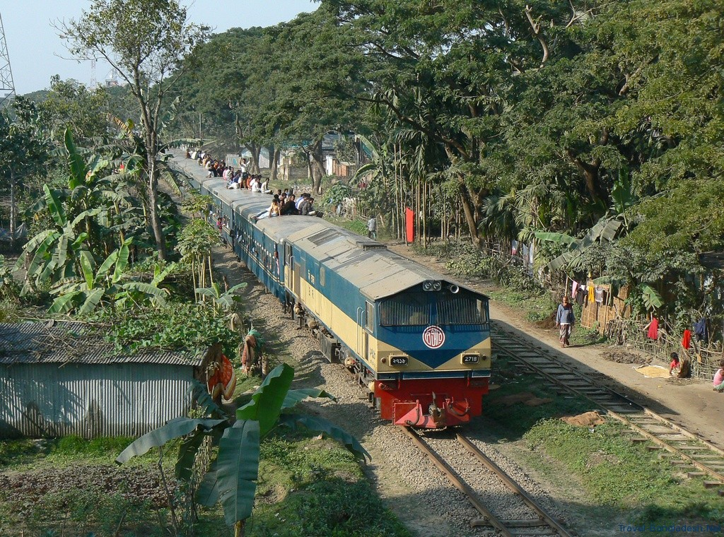

Slide 19

HOME WORK
Think you are going to travel to your grandparents’ house by a train. Now write a short composition about your preparation before travelling and your experience on the way. (Not more than 15 lines)

Slide 20
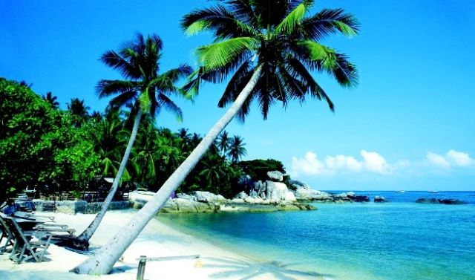
THANK YOU ALL

